Slide 1
St. Joseph’s Special Education Center BROTHERS OF CHARITY
Center for
Youths of Special Needs.
No- 10, Advocate Road
Batticaloa.
T.P.0652225595/0771615438. Email-pariskaran80@gmail.com

Slide 2
This is our Center.
The Former Catholic Press Building was renovated to start this Vocational Training Center.

Slide 3
Forming youths with special needs to be independent, infusing confidence and courage for their betterment and gainful living.
Our Vision

Slide 4
Imparting Technical Knowledge and Skill to the specially talented youths who are dependent on others for their day-to-day living throughout their life, who are considered to be a burden to the family and the society.

Slide 5
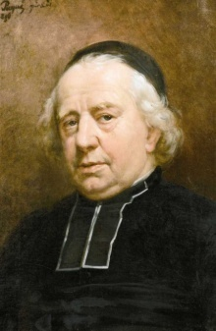
Our Founder
Rev. Fr. P.J. Trist a priest from Belgium born in 1760, in his zeal for work of mercy founded 2 Men & 2 Women Religious Congregations to take care of the poor, destitute, sick and old people who are in need of care and love.

Slide 6
Our Congregation
Our present Superior General of the “Brothers of Charity” Religious Congregation is very. Rev. Bro. Rene Stockman. F.c. Under his guidance and support this Special Training Center for youths of Specially Talented is established.

Slide 7
Our Recruits.
We recruit youth Trainees who are with special needs, in and around Batticaloa and in the whole of Eastern Province, regardless of ethnic and religious background. Also it is absolutely free of charge.
The duration of this course is maximum 4 years, including 1 year of “On the Job Training”

Slide 8
Our Training
Most of these youths are illiterate and below standard. We categorized our teaching based on:
Alphabets, Numbers, Measurements, Arithmetic, Reading & Writing.
Identification of money value, counting and cash dealings.
Shopping buying, selling, personal and social contacts.
Travelling, Ticketing & behaviour in public.
Impart Technical skill to ones ability and market demand.

Slide 9
Our Training Continued
The topics listed above and other qualities like etiquette and manners are also taught to improve their quality of life.
The morality of the beneficiary is improved radically.
The Courage and self confidence is infused in them.
Ability to earn an income by the beneficiary for the family, rather than a burden to them.
When family support is denied , the skill learned should give a helping hand to live on.

Slide 10
Recruitment
We are a new budding Institution, declared open on the 22nd of August 2015.
The classes commenced for the first time with 3 Girls and 4 Boys on the 18th of November 2015.
For the moment we are asked to recruit youths who are mentally disabled and not the physically affected ones.
Now we have 20 Trainees participating regularly 5 days a week from 8.30 Am to 2.30 Pm.

Slide 11
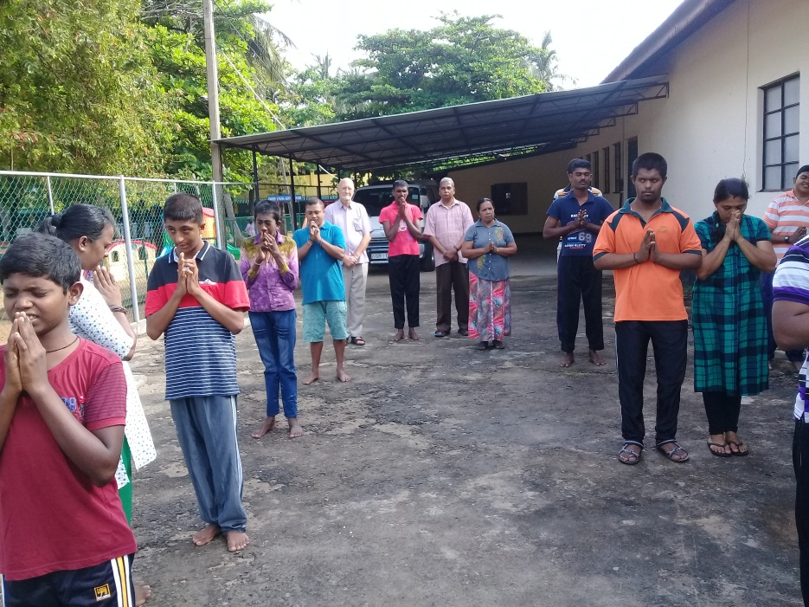
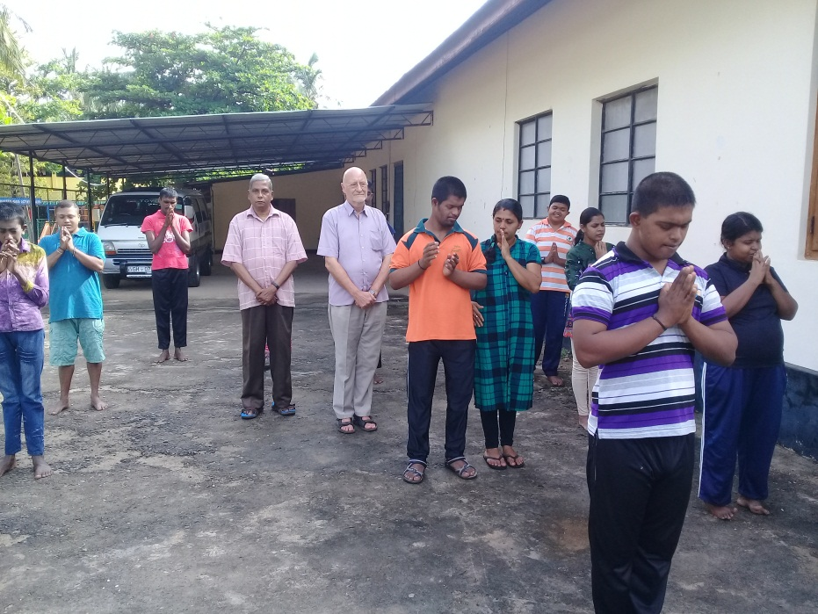
Morning Prayer
A common Prayer is said by the leader & they repeat invoking the blessing of God of their believe.

Slide 12
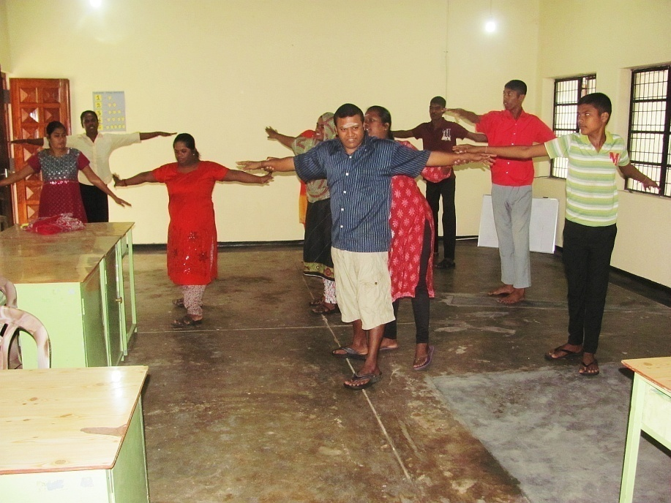
Morning Exercise.
A leader is selected to conduct the Exercise under the supervision of the teachers.
The teachers help them when they fail or could not cope up with the exercise.

Slide 13
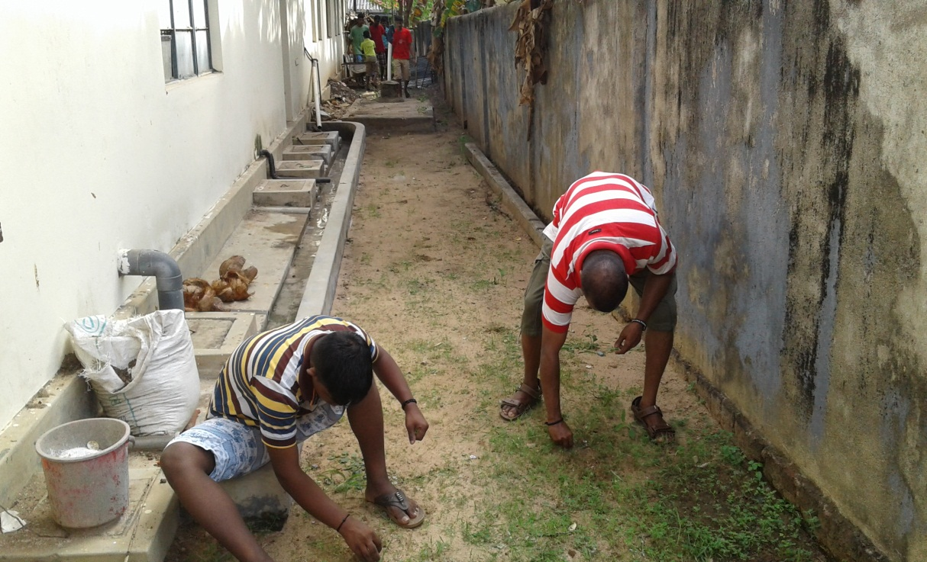
General Cleaning.
The Trainees are grouped to take up cleaning and sweeping to keep the house and the surroundings clean

Slide 15
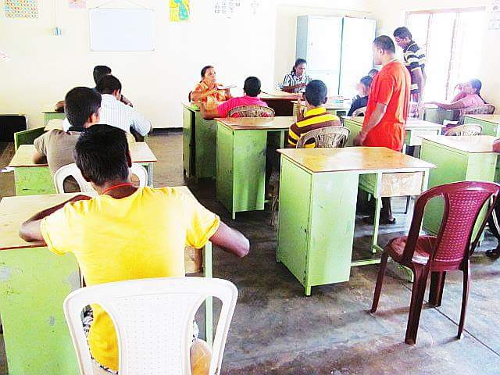
In the class room
The boys occupy one side and the girls take the other side and thus they are separated.
The learning materials are supplied by the center.

Slide 16
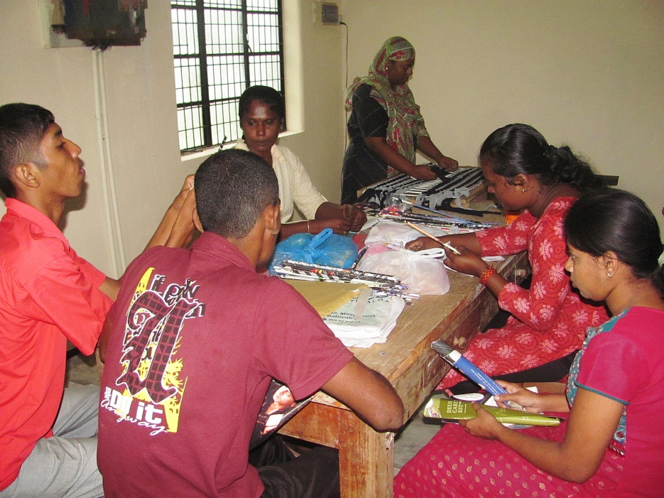
In the Work Place
We are in the process of assessing the ability of the Trainees giving them variety of handicraft works.
On finding their interest and capabilities, they will be given training in that trade, giving opportunity to master that skill.

Slide 17
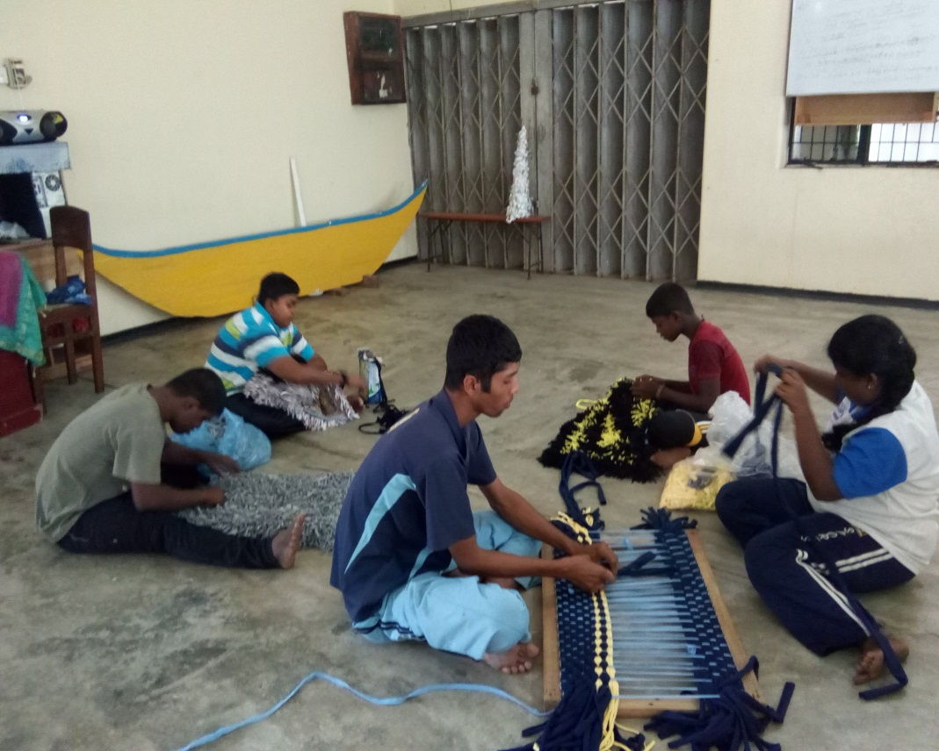
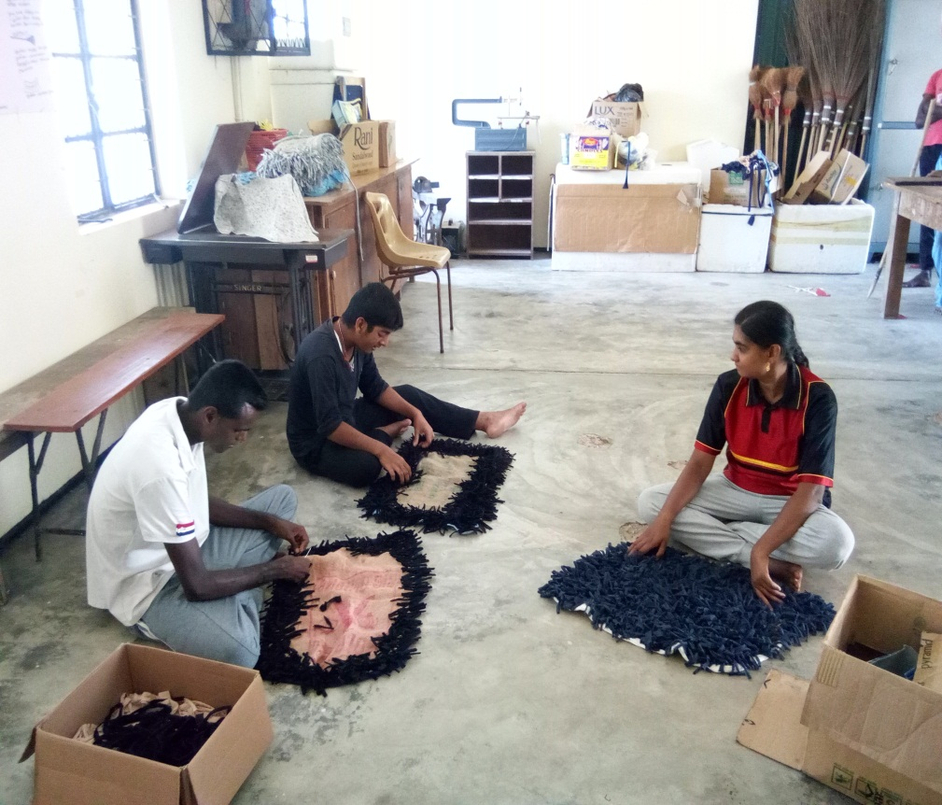
Carpets making

Slide 18
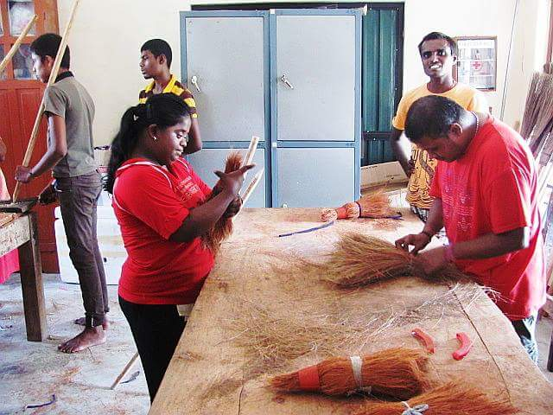
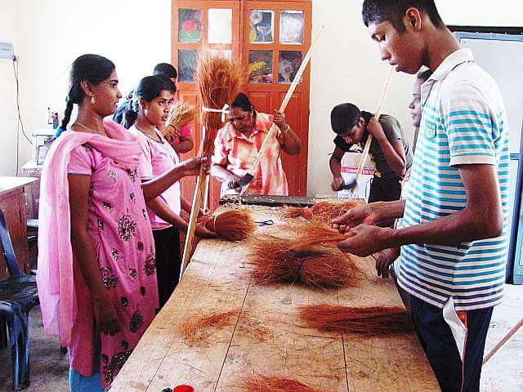
Broomstick making

Slide 19
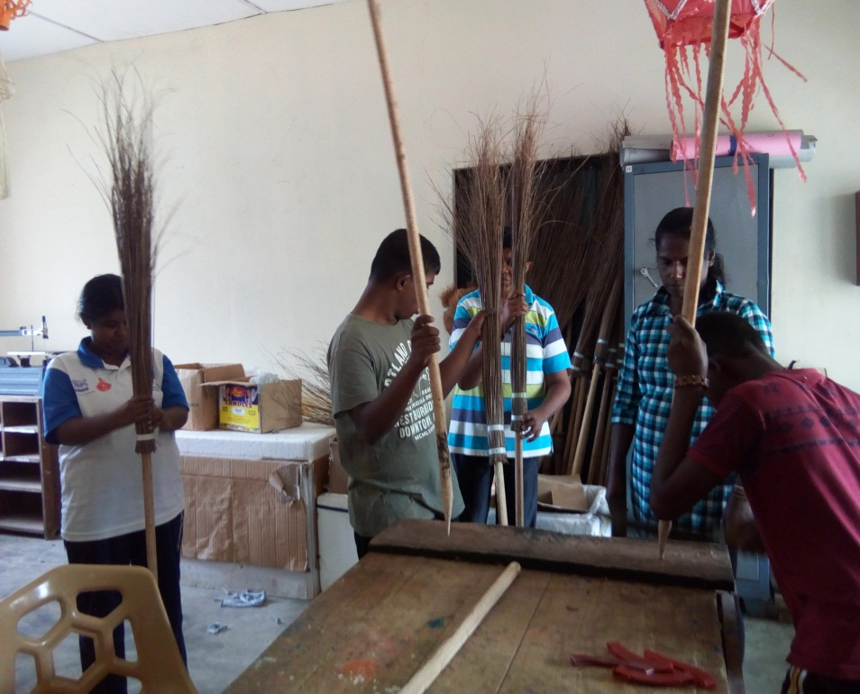
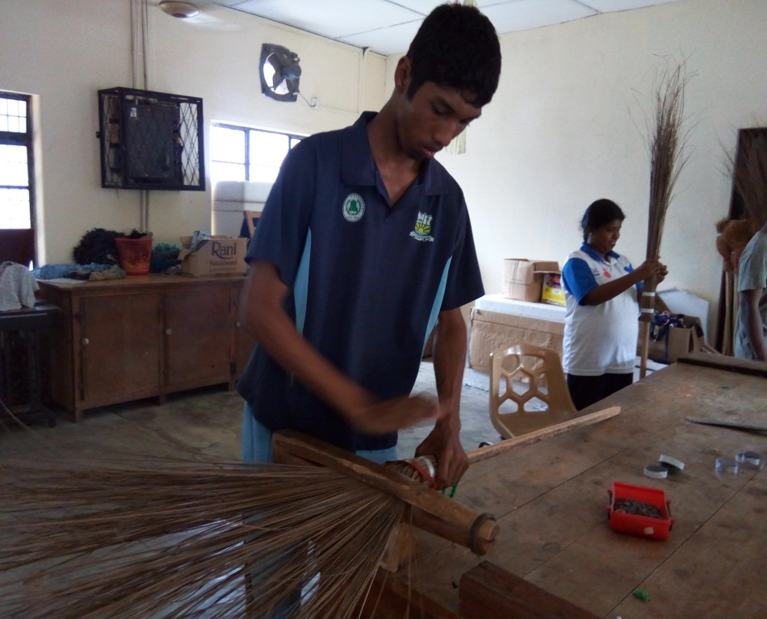
Ekal Broom

Slide 20
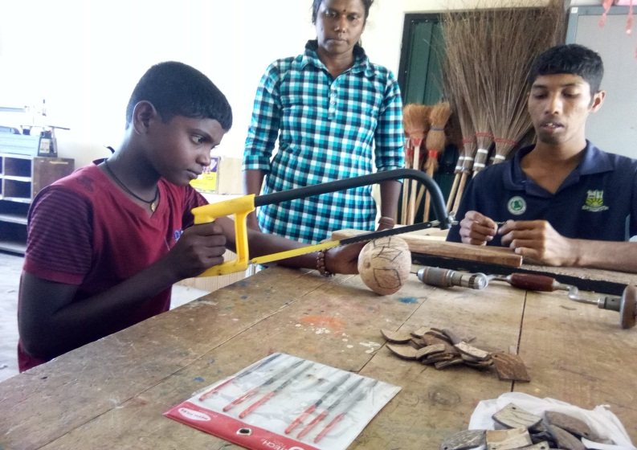
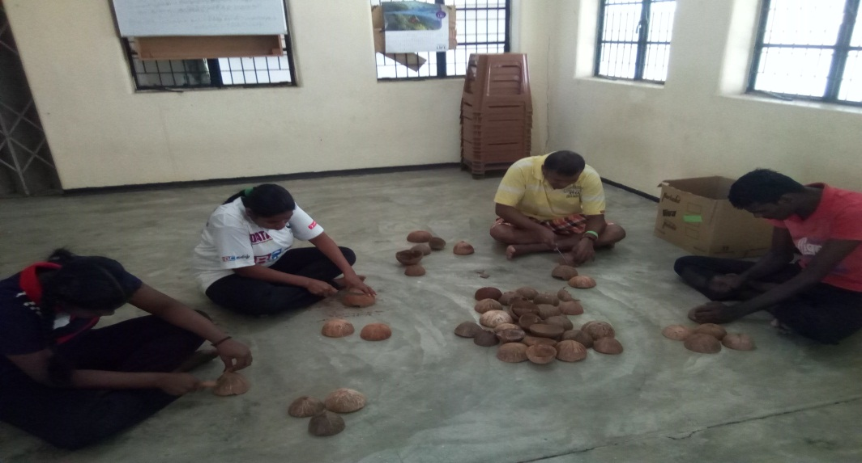
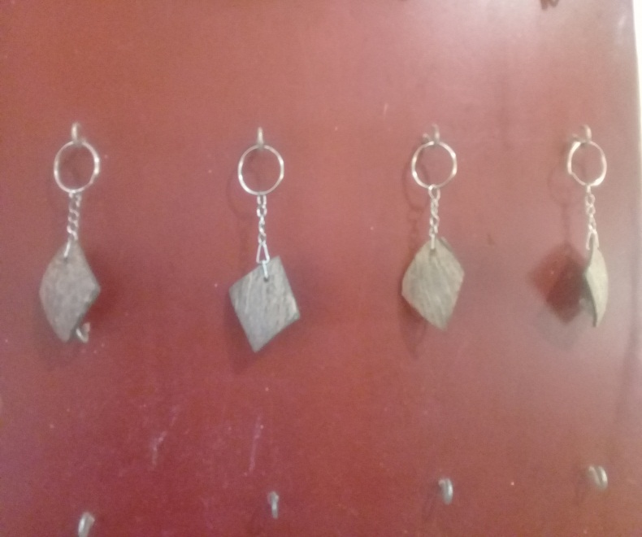
Making Key Tecs

Slide 21
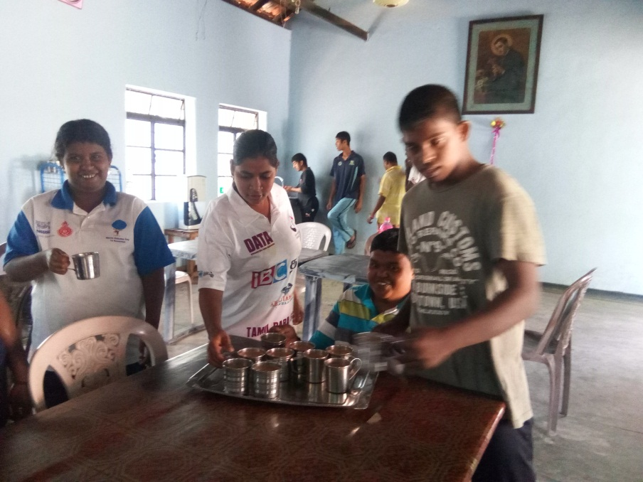
In the Refectory.
At 10.30 they take a Tea Break for half an hour.
They are served with some short eats and a cup of Tea.
At 12.00 Noon they come to the table with the food brought from home in the morning or some body brings lunch at noon.

Slide 22
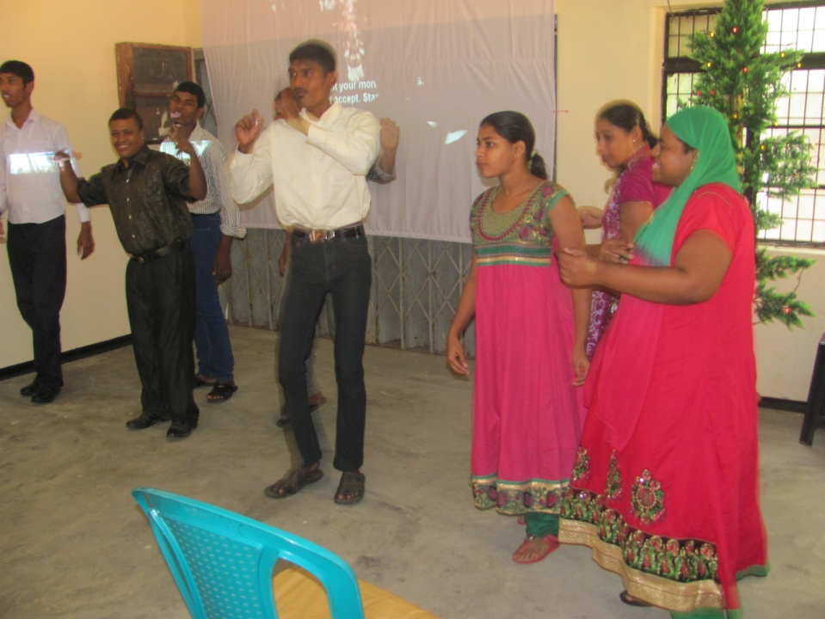
Year End get together
Regularly after 15th of December 0n the last day of the school term we have a concert and grttogrther for service uses and staff We entertained them with Music, Video, Refreshments and dance, opened for all.
Presents were distributed to the Trainees and Staff of the Institute.

Slide 23
Future Plan
We will include Physically affected youths in the training , whom we think are the most suitable for this type of training.
Children affected with Autistic behaviours are also our next task to include in our training.

Slide 24
Our Future Planes
Making Cement Blocks
Making Flower Tree products
Making Palmyra things products
Making Handles
Making Vegetable Garden
Making Basic computer knowledge

Slide 25
Our Trainees and the Staff.

